Slide 1



Hardware and Software Fundamentals of
Intelligent Computing
Systems

Slide 2
Lecture 37: Performances Metrics
FLOPS, Bandwidth, Latency, Utilization, Roofline Model

Slide 3

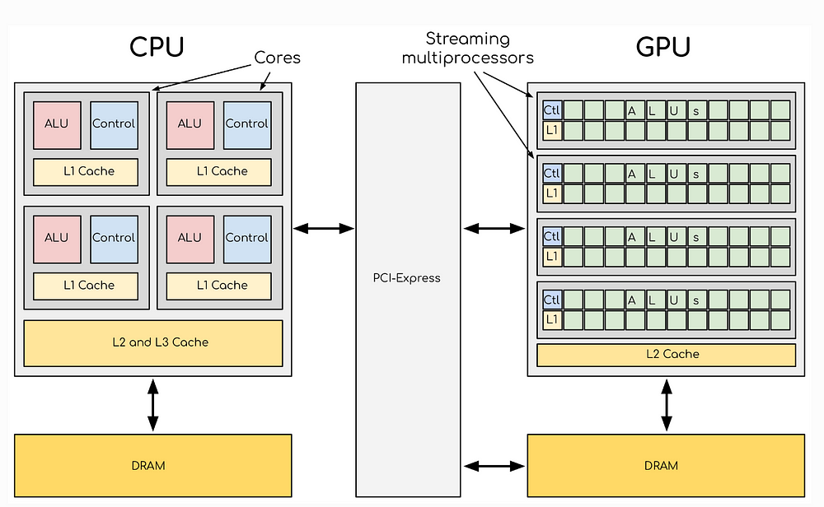
Why Do We Need Performance Metrics?
In High-Performance Computing (HPC) and system optimization,
we need to quantify program and hardware performance — different metrics reveal bottlenecks at different levels
Common Performance Metrics
FLOPS
Bandwidth
Compute Capacity
Bandwidth
Latency
Utilization
Latency
Resource Utilization
Roofline Model
Performance Ceiling Model
Image source: Medium - CPU vs GPU Architecture

Slide 4
Classification of Performance Metrics
Compute Capacity
Data Access Capability
Compute Bound
Memory Bound
FLOPS
Bandwidth
Measures the number of floating-point operations a processor can execute per second — the core metric for compute-intensive task performance.
Represents the amount of data transferable per unit time, determining throughput capacity for data-intensive applications.
Utilization
Latency
Reflects the actual usage efficiency of hardware resources, helping identify whether compute units are fully utilized.
Represents the time required to complete one data access, directly affecting program responsiveness and real-time performance.
Roofline Model used to analyze both bottleneck types, helping determine whether a program is compute-bound or memory-bound

Slide 5
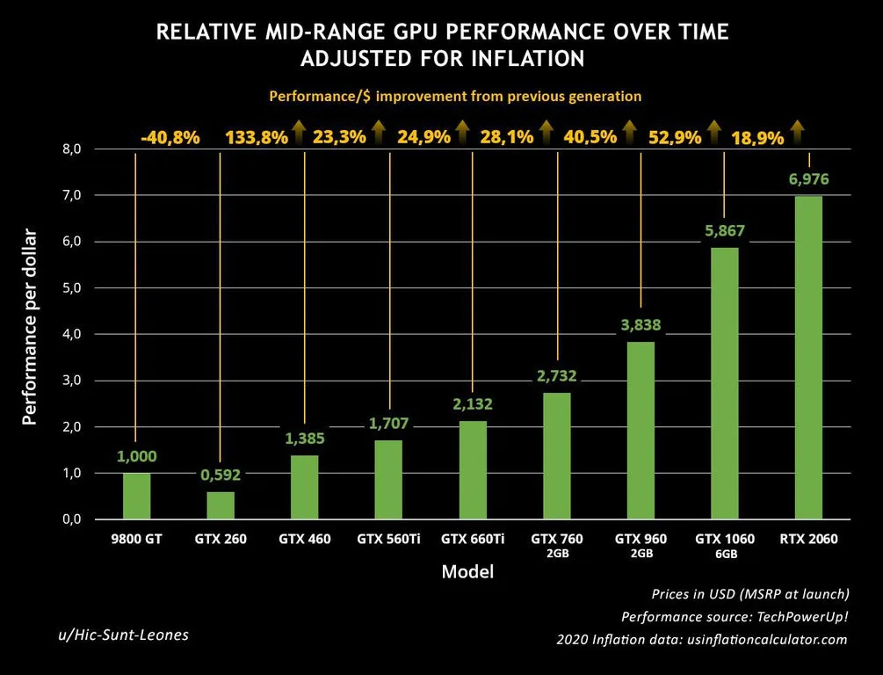
What is FLOPS?
FLOPS = Floating Point Operations Per Second
Represents how many floating-point operations can be executed per second
Common Units
MFLOPS
= 10⁶
GFLOPS
= 10⁹
TFLOPS
= 10¹²
PFLOPS
= 10¹⁵
FLOPS is the core metric for measuring compute capacity
Image source: The FPS Review - GPU Performance Growth

Slide 6
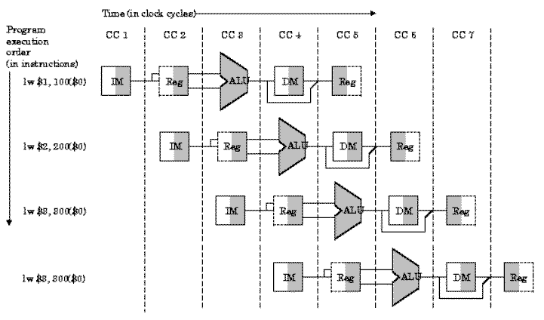
FLOPS Calculation Example
Assumed CPU Specs
Clock Frequency
3 GHz
FLOPs per Cycle
8 FLOP
Theoretical Performance Calculation
FLOPS = Frequency × FLOPs per Cycle
= 3×10⁹ × 8
= 24 GFLOPS
Note: This is the theoretical peak; actual performance is typically lower
Image source: University of Florida - CPU Pipeline

Slide 7
Actual FLOPS vs Theoretical FLOPS
Theoretical Peak
Actual FLOPS
The theoretical peak is entirely determined by hardware specifications, representing the maximum performance a processor can achieve under ideal conditions.
Actual FLOPS is determined by program execution conditions, influenced by a variety of complex factors.
Based on CPU/GPU core count
Usually far below the theoretical peak
Based on clock frequency
Affected by multiple factors
Based on instructions per cycle
Requires optimization to improve
Key Influencing Factors
Memory Access
Branch Prediction
Instruction Dependencies
Cache miss

Slide 8
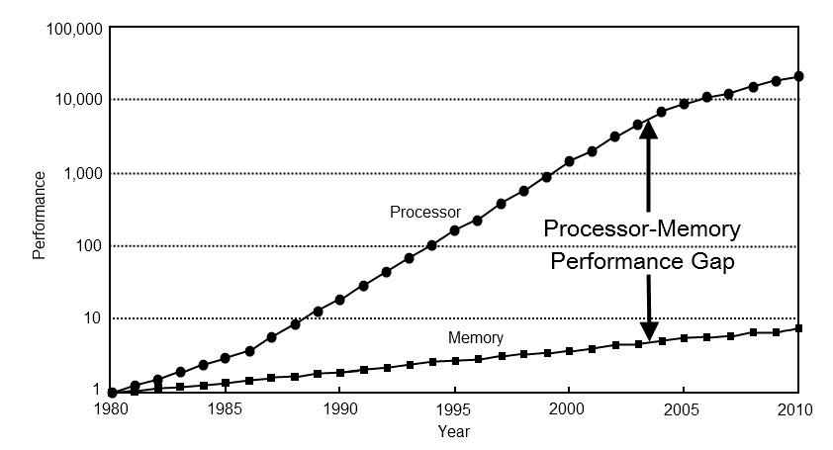
Bandwidth
Bandwidth
Represents the amount of data transferable per unit time
Common Units
MB/s
Megabytes/second
GB/s
Gigabytes/second
TB/s
Terabytes/second
Use Cases
Memory Bandwidth
Disk Bandwidth
Network Bandwidth
Image source: ForrestTheWoods - Memory Bandwidth

Slide 9
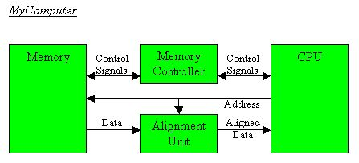
Bandwidth Example
Assumed Conditions
Memory Bandwidth
100 GB/s
This means:
Up to 100 GB of data can be read per second
Calculation Example
If the program needs to read
200 GB of data
Theoretical minimum time
= 200 GB ÷ 100 GB/s
Image source: University of Pittsburgh - Memory Controller
= 2 seconds

Slide 10
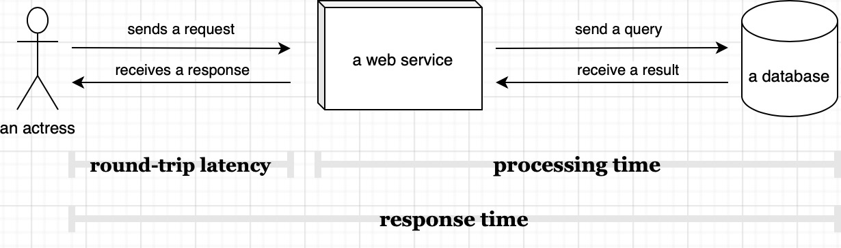
What is Latency?
Latency
Represents the time required to complete one operation
Typical Scenarios
Memory Access Latency
Network Latency
Disk Access Latency
Common Units
ns
μs
ms
Nanosecond
Microsecond
Millisecond
10⁻⁹ second
10⁻⁶ second
10⁻³ second
Image source: Scalable Developer - Latency Timeline

Slide 11
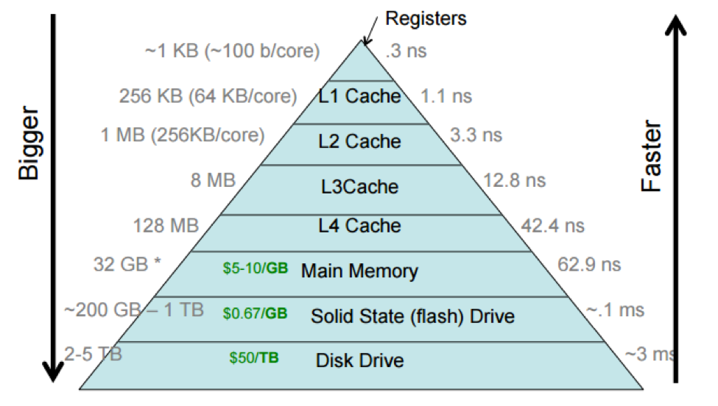
Latency Examples
Typical Memory Hierarchy Latency
L1 Cache
~1 ns
L1 Cache
L2 Cache
~4 ns
L2 Cache
DRAM
~100 ns
Main Memory
Note: The farther the memory level, the greater the latency
Image source: Brown University - Memory Hierarchy

Slide 12
Latency vs Bandwidth
Latency
Bandwidth
How long does a single access take?
How much data can be processed per unit time?
Measures the time to complete one independent operation, focusing on the response speed of individual requests.
Measures the total data a system can process per unit time, focusing on overall throughput capacity.
Analogy
Latency = Car startup time
Bandwidth = Number of highway lanes
Time required to start moving from a standstill
Number of vehicles that can pass simultaneously

Slide 13
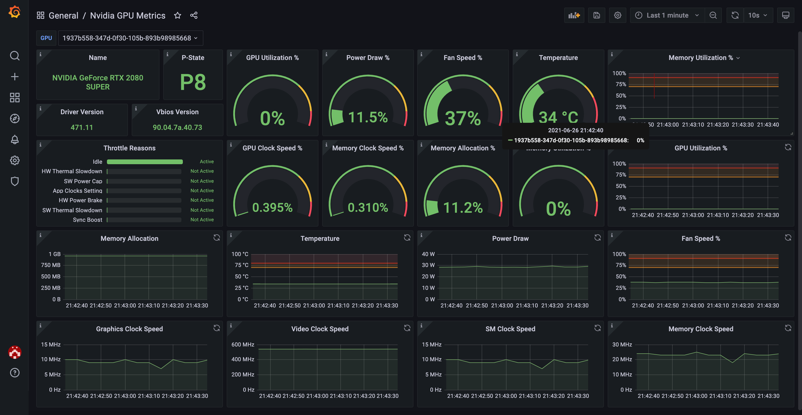
Utilization
Utilization
Actual usage level of hardware resources
Formula
Utilization = Actual Performance / Theoretical Peak
Typically expressed as a percentage
Calculation Example
GPU Theoretical Performance
10 TFLOPS
Actual Program Performance
5 TFLOPS
Image source: Grafana - GPU Metrics Dashboard
Utilization
50%

Slide 14
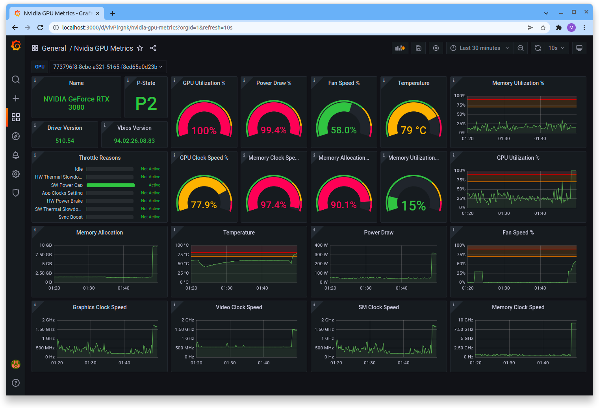
Why Utilization Matters
Even with powerful hardware
if utilization is low → performance will still be poor
Common Causes of Low Utilization
Memory Bottleneck
Data supply cannot keep up with computation speed
Synchronization Wait
Threads/processes waiting for synchronization
Load Imbalance
Some cores idle, others overloaded
I/O Wait
Waiting for disk or network I/O to complete
Image source: Lambda Labs - GPU Monitoring Tools

Slide 15
Two Types of Performance Bottlenecks
Compute Bottleneck
Memory Bottleneck
Compute Bound
Memory Bound
Characteristics:
Characteristics:
FLOPS-limited, compute units at full load
Bandwidth-limited, insufficient data supply
Optimization Approach:
Optimization Approach:
Algorithm optimization, parallelization, SIMD
Data layout optimization, cache optimization, blocking
Need to improve compute efficiency
Need to improve data access efficiency
Key Insight: Different bottlenecks require different optimization strategies — identifying the bottleneck type is the first step

Slide 16
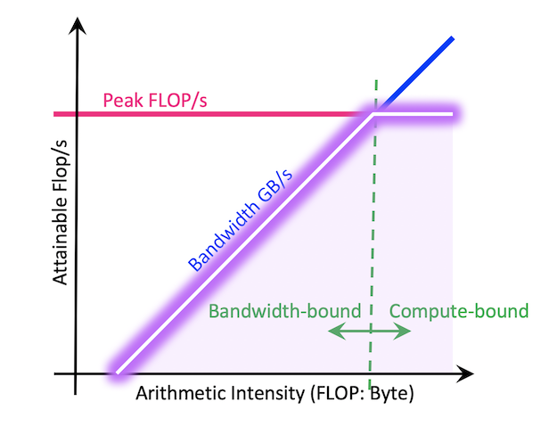
Introducing the Roofline Model
Roofline Model
A visual performance analysis model
Proposed by: Berkeley Lab
Lawrence Berkeley National Laboratory
Core Purpose
Identify program bottleneck
Determine if it's Compute Bound or Memory Bound
Guide optimization direction
Choose optimization strategy based on bottleneck type
Image source: NERSC - Roofline Performance Model

Slide 17
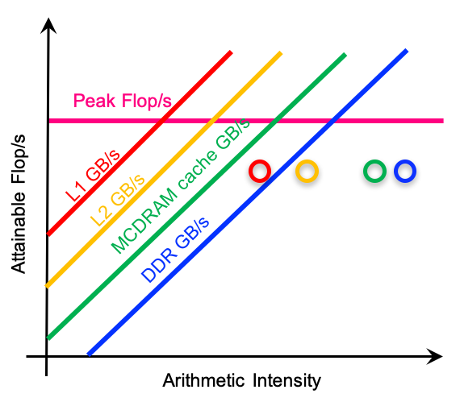
Roofline Model Axes
X-Axis
Arithmetic Intensity
= FLOPs / Byte
Arithmetic Intensity: floating-point operations per byte of data
Y-Axis
Performance
= FLOPS
Performance: floating-point operations per second
Image source: NERSC - Roofline Hierarchy

Slide 18
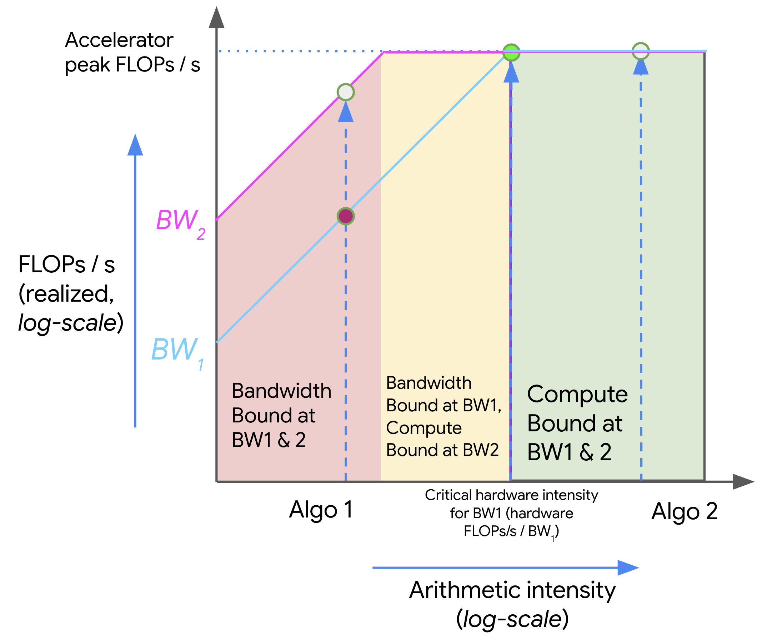
Two Constraints in the Roofline Model
1
Bandwidth Line
Memory Constraint
Diagonal line representing memory bandwidth limit
2
Compute Roof
Compute Ceiling
Horizontal line representing theoretical peak performance
Key Constraint: Program performance cannot exceed either of these two lines
Image source: JAX-ML - Roofline Model

Slide 19
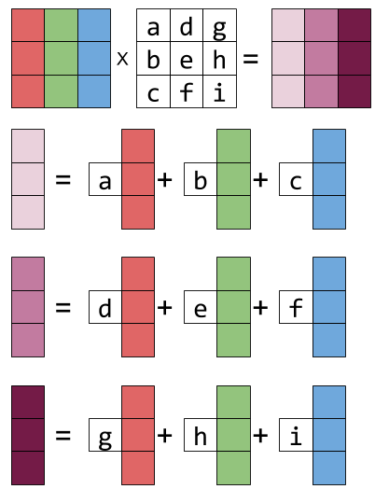
Arithmetic Intensity Example
Matrix Multiplication
Computation
O(n³)
Data Volume
O(n²)
Therefore: Arithmetic Intensity is very high
= O(n³) / O(n²) = O(n)
Note: more likely to be Compute Bound
Image source: Eli Bendersky - Matrix Multiplication

Slide 20
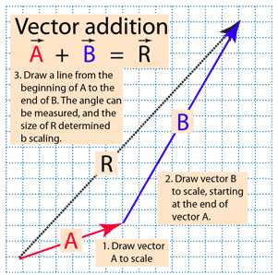
Memory Bound Example
Vector Addition
C[i] = A[i] + B[i]
Operation: 1 addition
Data: Read A[i], B[i], write C[i]
Few computations
Many data accesses
Arithmetic Intensity Low
Conclusion: typically Memory Bound
Image source: HyperPhysics - Vector Addition

Slide 21
How Roofline Guides Optimization
Bandwidth Region
Compute Region
Memory Bound
Compute Bound
Optimization Approach:
Optimization Approach:
Increase data reuse
SIMD vectorization
Cache optimization
Parallelization
Blocking technique
GPU acceleration
Core Idea: Select targeted optimization strategies based on where the program falls in the Roofline chart

Slide 22
Summary
Key Performance Metrics
FLOPS
Bandwidth
Latency
Compute Capacity
Data Throughput
Single Access Time
Utilization
Roofline Model
Resource Utilization
Performance analysis tool for identifying bottleneck types and guiding optimization
Understanding these metrics is the foundation of high-performance computing optimization
Mastering performance analysis is the key to writing efficient programs

Slide 23

The Solution: FlagOS, a Unified AI Software Stack

Slide 24








https://space.bilibili.com/3546791834290849
https://github.com/flagos-ai
https://www.zhihu.com/people/95-22-20-18/posts
https://flagos.io/Home

Slide 25

Thanks for your time！

